Slide 1

Absence Management
Process Training

Slide 2
Today’s Agenda
Absence Management Service Overview
  Leave initiation
  Process
Responsibilities
  Employee
  Employer
  The Standard
Online Demonstration
Notes:
Sample topics listed - adjust based on your audience/needs

Slide 3
What’s changing November 1, 2019
The Standard will manage the following programs:
FMLA and state-mandated leaves
Tracking and eligibility for leaves
USERRA (leaves for military members)
Short Term Disability
Any employee who contacts The Standard about a leave type that is managed by City of Memphis will be referred back to the employer’s HR department.
Notes:
Adjust program list as needed for your audience

Slide 4
My employee is requesting a leave. Now what?
Request Method | Steps to Take
Employee informs his/her supervisor they will be out | Supervisors should know: How to identify requests that may fall under FMLA Where to direct the employee for assistance (The Standard, HR, HR website, an FAQ document)
Employee reaches out to the HR department | HR directs the employee to call The Standard HR sets up informational meeting HR determines possible need for other services that are not tied to The Standard
Employee calls The Standard directly | The Standard sets up an appropriate leave and potential claim The Standard refers employees to HR for any needs outside our administration The Standard directs employees to work with their supervisor and follow regular call-in procedures
The FAQ provides instructions on the regular call-in procedure for employees and walks them through the appropriate next steps.

Slide 5
How can I help?
Direct employees to call The Standard to report their leave of absence
Educate employees on where they can locate the FAQ:
  Total Rewards Site www.totalrewards.memphistn.gov
Set expectations about employee behavior during leave
  Stay in contact with employer and The Standard regarding return to work plans
  Remain accountable in the leave and disability process

Slide 6
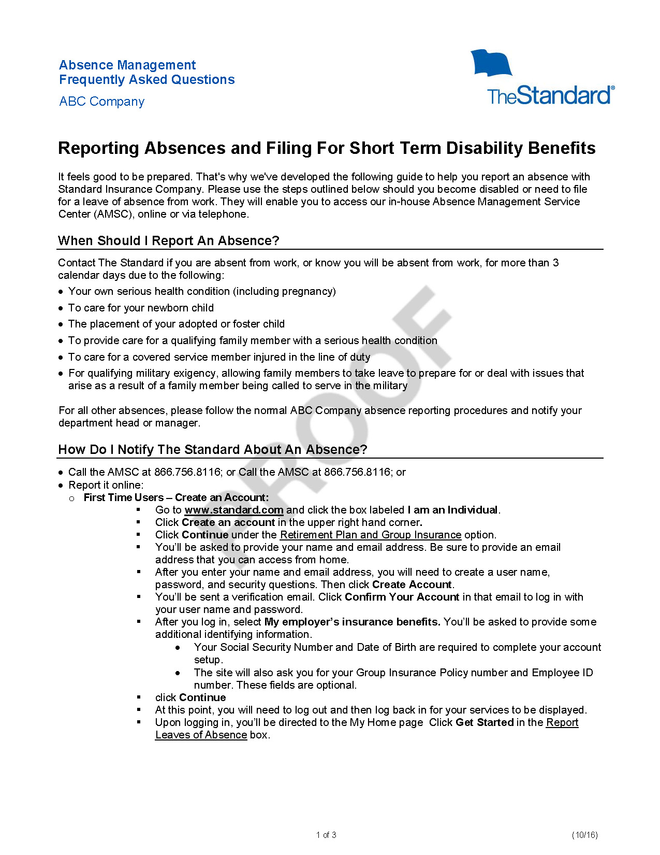
Frequently Asked Questions Guide
(Provided Prior to Leave Initiation)
We provide an FAQs document to help your employees understand the process for initiating a leave/claim
You may publish this guide to your intranet or supervisors may provide copies to employees

Slide 7
The Intake Process

Slide 8
Initiating a Leave of Absence
Employees may contact The Standard in three different ways:
Live Intake
The Standard has a dedicated Absence Intake team available weekdays between 8 a.m. and
8 p.m. Eastern
Your organization will have a custom phone number with a personalized greeting
Two intake locations
  Portland, OR
  Alta Vista, VA
Spanish-speaking agents and interpreter services are available
IVR
Employees with existing leaves can call The Standard’s Intelligent Voice Recognition system 24/7 to:
Add more time to an existing leave
Check claim status
Request a call-back
Web Intake
Employees have 24-hour access to our mobile-optimized Absence Portal
Initiate a leave of absence
Check leave balances
Check the status of a leave
Add more time to an existing leave
1.833.878.9034
www.standard.com
Notes:
May need to remove custom phone number bullet point or web intake box as appropriate for your audience

Slide 9
Intake Call
From a 7-10 minute intake call, the Contact Center agent will be able to:
Record the new absence and set up all applicable leaves: Federal, State, Short Term Disability
Send the initial claim packet and leave of absence paperwork to the employee
Fax an Attending Physician’s Statement (APS) to the doctor’s office if the employee provides the treating physician’s contact information
Answer general questions about the status of an existing claim
Did you know? Our Contact Center has a number of Spanish-speaking agents and can enlist the help of an interpreter for languages other than English or Spanish.

Slide 10
Intake Call System and Communications
Your eligibility file feed will be consumed directly into our system and will drive these functions:
Intake agent will see key demographic information about your employees
The system will determine eligibility using that demographic information
    Hire date
    Hours worked in the last 12 months
The intake agent will outline important next steps for the employee
A closing script tells the employee about next steps
Directly after the intake call, a printed employee packet will be mailed
The employee may also choose to receive this paperwork via email
    Work state
    Disability benefits

Slide 11
Next Steps
Claim Assignment
The leave/claim will be assigned to a Leave and Disability Examiner after intake.
Standalone leaves will be assigned to a Leave Specialist The Standard will identify “fast-track” claims (pregnancy)
Written Communications
Initial communications will be sent to primary leave/claim stakeholders.
Leave and Disability packet will be mailed to employee within 24 hours of intake (email option also offered) The initial leave/disability request will be sent to designated recipients at City of Memphis
Telephonic Outreach
The Standard will work to obtain medical documentation for combo claims and will keep in touch with the employee.
The Standard will fax the Attending Physician’s Statement to the physician’s office and call to follow up every 48 hours until we can confirm receipt of APS and determine turnaround time The Standard will conduct an employee interview to collect information and set expectations

Slide 12
Impact of Telephonic Outreach
Helps minimize escalated claim issues because employee has been educated on the process
Allows for accelerated STD and FML decisions (typically within 48 hours)
Helps increases timeliness of decisions
Hard copy of Attending Physician’s Statement is still received; we just don’t need to wait for it
Similar process used for extensions, but paper medical is sought if appropriate detail cannot be obtained by phone
Complex diagnoses still require paper certification
Promotes increased and expedited referrals for clinical intervention/review

Slide 13
Ongoing Case Management

Slide 14
Our Leave and Disability Claim Process
1
2
3
Intake
Leave & STD Concurrent
Transition Roundtable
Clinical team review and
eligibility determined
Single Point of Contact:
Leave and Disability Examiner
4
Outreach to Employee, Physician and Employer
Transition to
LTD Benefits
Combined Leave/STD Correspondence
Outcome Projected
Coordinated Leave/STD Decisions
clinical input on complex and
behavioral health claims
RTW Expected
RTW With
Assistance
Recovery Not Expected
Return-to-Work
Date Established
Ongoing LTD Case Management
Return to Work During STD
STD Case Management
RTW support continues
= Clinical touchpoint as needed
= Workplace Possibilities touchpoint
Notes:
Here’s the whole lifecycle of our leave and disability processes at a glance…
When Leave and STD are concurrent – your employee will have a single point of contact: one Absence Coordinator who’ll handle their leave and short term disability claim.
That makes it a lot simpler, streamlined and easier for the employee to understand:
They’ll receive combined correspondence explaining eligibility and benefits
And a coordinated Leave/STD decision.
The “yellow crosses” on key steps indicate clinical touchpoints, where clinical resources get involved as needed, including:
Complex or multiple diagnosis claims
All behavioral health claims
The blue symbol of a person shows where and when a Workplace Possibilities consultant will engage as needed for return-to-work assistance or during a LTD decision process, as part of a transition roundtable that also includes the benefits analyst, nurse case manager and input from the treating physician.
We use proprietary claim analytics as part of that decision and predictive modeling to determine what level of support an employee needs, such as clinical assistance with return to work, or Social Security advocacy.
If the employee is approved for long-term disability, our goal is a seamless transition, with no interruption in their benefits.
[ADDITIONAL NOTES: CAN REFERENCE LATER WHEN TALKING ABOUT PHYSICIANS]
Clinical input for STD claims is based on clinical referral guidelines: clear protocol for clinical involvement. Not just an analyst’s judgement call. We provide structure to make sure the right claims are referred to a nurse.
Transition Roundtable: brings expertise to table and showcases collaborative effort.

Slide 15
Our Leave-Only Process
1
2
3
4
Intake
Leave Management
Combined Communications
Robust Reporting
One phone call or via web portal.
Includes intake from closed STD claim to intermittent leave.
Leave Specialists manage leave-only processes, including FML, intermittent leaves, re-certification, etc.
Minimize employee confusion and keep employer informed.
HR can easily track
claim status, and view standard or custom reports, and other
metrics.
One person.
One contact.
One Leave Specialist, focused exclusively on leave management, provides a single point of contact.
Key Capabilities
Initial eligibility verification within 24 hours
Real-time intermittent time reporting and notification
Tracks multiple frequencies and durations
Mobile optimized portal with real-time reporting
Manages ADAAA leave types
Verifies and coordinates return-to-work dates
Coordinates federal/state and company leaves
Automatically sends notifications for re-certification
and pending leave exhaustion
Notes:
Our leave-only process and Absence Management system is fast and informed.
By design, our leave-only process is very similar to our coordinated Leave/STD process.
Employee has the same experience regardless of what they call in for.
Key difference: who handles the claim
One person. One contact. Leave-only claims are handled exclusively by our Leave Specialists who provide a single point of contact:
They’re trained in FMLA and absence processes and do not handle disability claims
They’re specialists who focus in on the complexity of FMLA-only claims
They offer a single point of contact for employees
Answer any questions that employees may have during the certification process
Leave Specialists work within the same system as our coordinated STD/FMLA claims
This allows us to have consistency and the same robust tracking and reporting as during the coordinated Leave and STD process
Our Absence Management system has the key capabilities you’re looking for, including [SEE LIST ON SLIDE].

Slide 16
Telephonic Outreach – Pregnancy Fast Track
For simple pregnancy claims, The Standard can make leave and claim decisions without medical documentation.
Through Pregnancy FastTrack, The Standard can pre-approve claims by calling the physician to verify medical information
The Leave and Disability Examiner confirms the pregnancy and expected delivery date, and gathers any additional medical factors that could impact the decision
Two weeks prior to expected delivery, the Leave and Disability Examiner will contact the employee to confirm the delivery date and review claimant expectations upon delivery
Payments are released on the date of anticipated disability
The Standard will call the doctor on the expected delivery date to confirm
The claim will be adjusted based on the actual delivery date

Slide 17
Telephonic Outreach – Medical Interview
Once medical documentation is received, the Leave and Disability Examiner will conduct a medical interview with the employee
We can go beyond a paper diagnosis and understand the individual
Are there co-morbidities?
Is the employee following the treatment plan?
Is the employee seeing additional providers?
What are the expected return to work plans?
The Leave and Disability Examiner can drive out
  Claim and leave decision outcomes
  Expectations
  Next steps
  Return to work requirements

Slide 18
Key Contacts

Slide 19
Absence Team
Manager – Wade Boss
Oversees the Absence Services team
Reviews and responds to escalated leave/claim issues
Monitors Absence service performance
Provide periodic and “as needed” coaching
Assists with mandatory peer reviews and claim-storming sessions
Operations Specialist – TBD
Assists the manager on escalated leave/claim issues
Monitors Absence service performance
Assists with audits, training, etc.
Leave and Disability Examiner
Manages coordinated leave and STD claims
Leave Specialist
Manages leave-only cases (no coordinated STD claims)
Your Absence service team is located at our home office in Portland, Oregon. They work in the same location as our primary Absence intake team.

Slide 20
Additional Resources
Absence Management Consultant – Miriam Baer
Provides ongoing support following go-live
Addresses federal/state leave law compliance questions
Provides any needed adjustments to Absence administration
  FAQ updates
  Online self-service and email configuration
Provides ongoing training and support for Absence and STD administration
Onsite Account Specialist – Tiffany Begley
Provides support to HR and Managers when navigating the system and general questions regarding services
National Accounts Consultant – Holly Keeton
Provides overall support and services, including billing, policy support, questions and issue resolution
Primary contact for questions or concerns on any products or services provided by The Standard

Slide 21
Whom to Contact When
Contact City of Memphis internal HR team with questions about:
Benefits administration or PTO administration for employees on leave
City of Memphis leave of absence policy
Benefit premium payments for employees on leave
Suspected leave abuse or misrepresentation
Contact Absence@standard.com for questions regarding:
A specific leave/disability claim
Response turnaround time is 24-48 business hours, depending on research needed

Slide 22
Whom to Contact When
Contact Tiffany.Begley@standard.com for:
Escalation of leave/claim issues (i.e. no response from Absence@standard.com within 24 hours, response urgently needed, etc.)
Absence Portal Setup, email communications
Contact Miriam.Baer@standard.com for:
Federal/state leave law compliance questions
Absence or Disability process questions or change requests
Adjustments to Absence Portal access
Adjustments to Absence correspondence
Contact Holly.Keeton@standard.com for:
Questions about products/services administered by The Standard
Service issues

Slide 23
Communications

Slide 24
Correspondence Timeline
Employee Letter or Outreach | Associated employer email? | Timing (business hours/days)
New request/ Leave notification | Yes | Within 24 hours of eligibility determination
Follow-up for certification non-receipt | No | 9 days following leave request
Incomplete certification | No | Only as applicable, within 5 days of receiving certification
Leave and STD decision | Yes | Decision: Within 5 days of receiving certification Notification: Within 24 hours of decision
Leave extension | Yes | Only as applicable
Recertification | No | Every 6 months (or sooner depending on leave circumstances)
Return to work letter | Yes | Sent 14 days prior to RTW date on file
Return to work verification | Employer email only | First business day after expected RTW date
Note: Employer review/response at the RTW verification step is crucial to the RTW process.

Slide 25
Concurrent Claim Management
Treating Physician |  | Employer |  | The Standard
If the completed paperwork isn’t on file, we will reach out to the treating physician’s office every 48 hours for the first 6 business days. |  | In the first 3 business days, you may need to: Clarify outstanding eligibility issues Provide data for the disability claim You will also receive an email once the claim decision is made. |  | Once the claim is complete: Review the information within 48 hours Render a decision Communicate the decision Mail letters

Slide 26
Leave Case Management
1. Paperwork Due Date
Employees have 15 calendar days from the date we confirmed eligibility to: Get the treating physician to complete their certificate Return the completed certificate to The Standard Note: If certification is not received by the deadline, the leave will be denied.
2. Leave Decision
Once the certificate is received, the Leave Specialist will render a decision and communicate the outcome: Letter to employee Email to employer
3. Non-Receipt and Late Certification
If late certification is received that supports the serious health condition, we will retroactively approve the entire leave. If the paperwork is received over 2 weeks late – we will reach out to verify if any employment action has been taken.

Slide 27
Intermittent Leave Management Process
Employee reports intermittent leave to their manager and to The Standard online, by phone or through the IVR system
Reported absences are verified against the employee’s medical certification (frequency/duration review)
The Standard sends an email notification to the employer’s HR team indicating the decision for each instance of intermittent usage
The Standard evaluates absence patterns
Resources are available to combat leave misuse
  Authentication and clarification of leave certifications
  Recertification sooner than 6 months if concerns develop

Slide 28
Return to Work Process
Throughout the leave/claim, The Standard will work with the employee to understand their return to work plans. Fourteen days prior to return to work, The Standard will send a letter to the employee and an email to the employer.
Return to work forms sent for an employee’s own serious health condition or for pregnancy are enclosed in the approval letter and the return to work letter.
For a claim/leave of 7 or more days, The Standard will reach out to the employee to find out if the expected return date has changed.
For a claim/leave of less than 7 days, The Standard will work with the employee to ensure they (or their physician) have the form prior to return to work.
Upon the employee’s scheduled RTW, The Standard will email the employer to verify that the employee has returned.
Notes:
Sample items listed. Adjust as needed.

Slide 29
Roles & Responsibilities

Slide 30
Employee’s Responsibilities
Initiating a Claim/Leave
Contact | Complete | Communicate
Call The Standard or go online to request a leave of absence or disability | Return all required paperwork to The Standard by the deadline* 15 days for FMLA 45 days for disability | Communicate return to work status to The Standard and the employer throughout the life of the claim
1
2
3
Employees should also:
Follow all department- or employer-specific absence reporting procedures such as notifying the supervisor in addition to notifying The Standard - timely filing for initial leave request is 14 days
Report any intermittent absences in a timely manner – timely filing for ongoing intermittent absences is 7 days
Submit all necessary claim/leave paperwork – including medical** – in a timely manner
* There may be instances where the FMLA will be approved and the disability will remain pending. In these cases, more medical information may be necessary to make a decision on the STD than is required for FMLA.
** For integrated STD claims, The Standard will reach out to the physician’s office, but it is ultimately the employee’s responsibility to ensure that we receive all information required to make a decision.

Slide 31
Employee’s Responsibilities
Short Term Disability Paperwork Submission
Attending Physician’s Statement
The Standard will fax the APS to the physician’s office within 24 hours of intake The Standard will make 3 attempts within the first 6 days to obtain a completed APS from the physician Completed paperwork is due 45 days from notice of claim
Authorization to Obtain/Release Information
Signed authorization is required in order for The Standard to speak with the physician’s office to obtain medical information used to inform our claim decision Failure to submit this form prevents The Standard from working with the physician on the employee’s behalf to obtain necessary medical information

Slide 32
Employee’s Responsibilities
FMLA Paperwork Submission
Certification of Healthcare Provider Form (CHCP)
Mailed and/or emailed* to the employee within 24 hours following eligibility determination Employee is responsible for providing this paperwork to the physician and returning the completed form to The Standard If paperwork is not received by the due date, the leave is subject to denial Completed paperwork is due 15 days from date of intake
* Emailed if requested

Slide 33
Employer’s Responsibilities
Initiating a Claim
Initiate | Communicate | Support
Provide The Standard’s FAQ sheet to employees filing a leave/claim File a leave/claim with The Standard if the employee is unable | Relay to The Standard any medical or other information the employee provides to HR or a supervisor that may assist in managing the claim Review and reply within 24 hours to email notifications from The Standard Anytime claim status changes, The Standard will provide an email notification | Send claim inquiry requests to absence@standard.com Implement internal procedures to support the leave management process Apply employer policies consistently to keep the plan out of jeopardy
1
2
3

Slide 34
The Standard’s Responsibilities
Claim Management
Initiate | Manage | Update
Facilitate the intake process Determine the employee’s eligibility for FMLA, any applicable state leave, company-sponsored leave and/or Short Term Disability | Send required notifications to the employee: initial packet/eligibility notification, approval/denial notification (including extensions), and return to work letter Gather and review necessary medical information, ensuring that it comes from an appropriate provider/ specialist Provide support in the return to work process | Provide status updates on leaves/claims via Absence Management System, AdminEASE online reporting system and email Respond to inquiries received via email and/or voicemail within 24-48 hours, depending on complexity and/or research needed
1
2
3

Slide 35
The Standard’s Responsibilities
Return to Work from Disability
Communicate | Remind | Contact
Communicate the expected return to work date in initial approval communication to employer and employee At this point, the return date is only an estimate; it could change based on the medical information provided by the physician | Send a return to work reminder letter to the employee 14 days prior to the end of the leave Return to Work Authorization Form – to be completed and returned to the employer Attending Physician’s Statement – to be returned to The Standard if the return to work date has changed | Email the employer 14 days prior to expected return to work date Confirm employee’s return with employer on the day following the expected return to work date
1
2
3

Slide 36
The Standard’s Responsibilities
Return to Work from Disability
If the employee does not return paperwork to their employer or The Standard and does not return to work on the expected date:
Their leave/claim will close and FMLA job protection will end The employee is no longer tracked by The Standard The employer should reference their employment policies and procedures
If an employee can return to work with restrictions:
Work with the employer to ensure that these restrictions can be accommodated
If The Standard is notified that the employee will not return to work:
Employee must provide updated medical information stating that they cannot return due to their medical condition Medical information will be reviewed to determine if ongoing disability is supported

Slide 37
Employer’s Responsibilities
Return to Work from Disability
Respond to the return to work verification email received the business day following the employee’s expected return
If an employee returns to work early:
Notify The Standard Do not permit an employee to return unless they have submitted a Return to Work Authorization – the return to work process must remain consistent for everyone
If you know the employee will not return to work on the expected date:
Respond to the email and provide The Standard with updated information The Standard will update the return to work record and reach out to the employee to obtain additional medical information required to extend the claim

Slide 38
Employer’s Responsibilities
Return to Work from Disability
If The Standard is notified that the employee will not return to work:
This is a separate email from the 14 day return to work reminder The Standard cannot close or extend the claim without the employer’s confirmation of whether or not the employee returned to work
Collect and review the Return to Work Authorization provided by the employee and signed by their physician
If the employee is released to full duty, notify The Standard and forward the release so we can close the claim If the employee is released with restrictions to duties and/or hours, contact The Standard and forward the note to absence@standard.com so the Leave and Disability Examiner can work with you to determine if the restrictions can be accommodated If the restrictions cannot be accommodated, the employee will be advised of this fact and the claim/leave will remain open

Slide 39
System Reference Slides

Slide 40
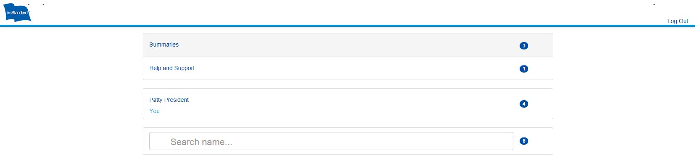
Portal – Summaries

Slide 41
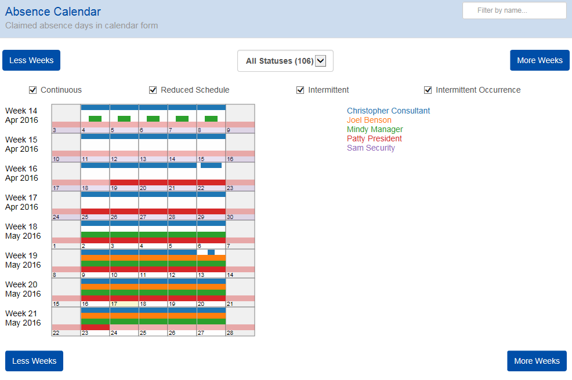
Absence Calendar
Provides summary
of leaves by reporting structure in calendar form
View current entitlement based
on employee’s leave usage
Update report filter
by status, leave continuity, employee and date range

Slide 42
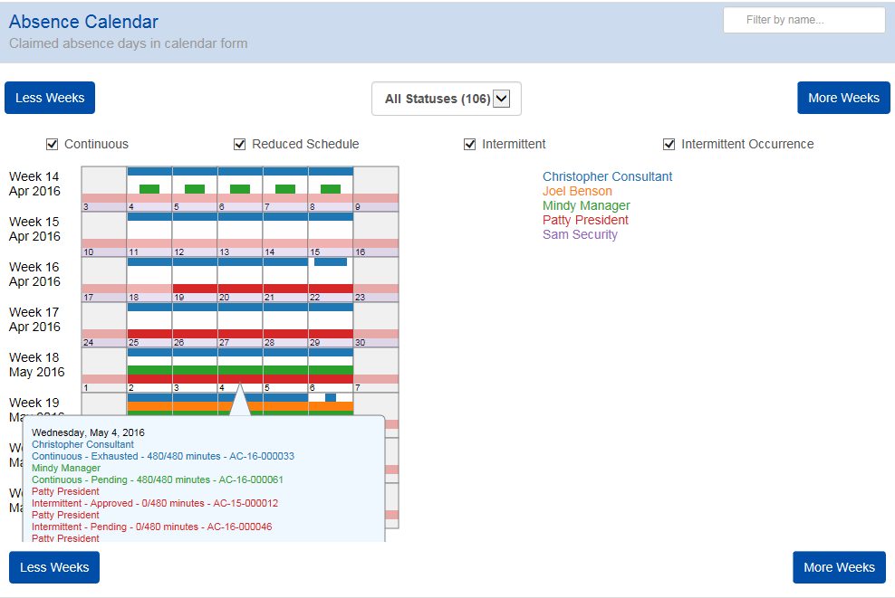
Absence Calendar
View the employee(s) out on leave for the day by clicking on that date in the calendar
Provides for the day by employee, the leave continuity, leave status, time requested and leave number
The color of the employee’s name is
the same color in the calendar chart

Slide 43
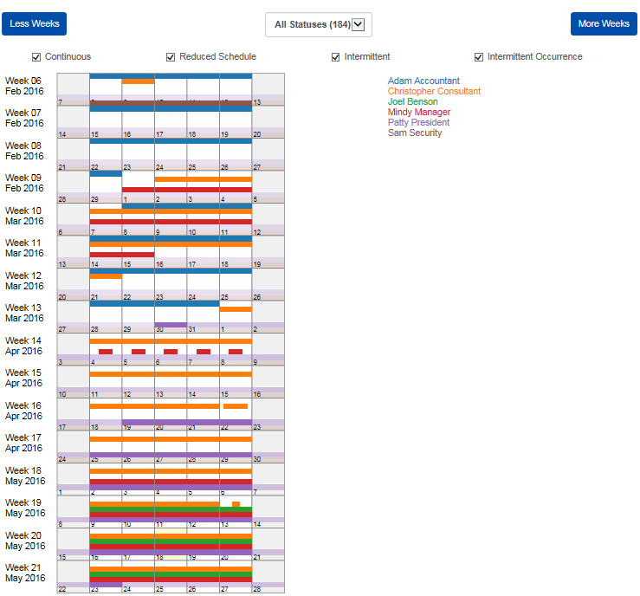
Absence Calendar
Modify the weeks in the absence calendar by clicking on “less weeks” and/or “more weeks”
Graphic view from manager or employee level showing how much time has been requested
Extended view helps with schedule/ resource planning

Slide 44
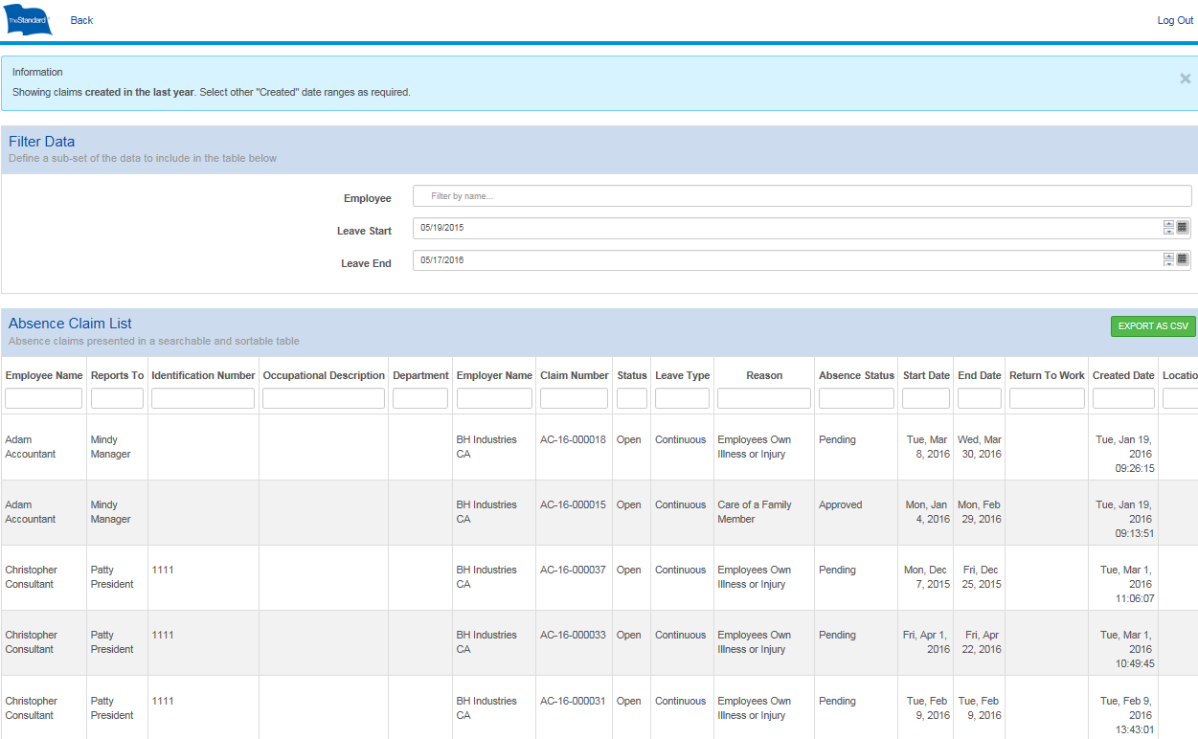
Absence Claim List
Provides summary of leaves in a searchable and sortable format
Report can be viewed on smart phone/tablet
Can export to Excel
Sort/edit online for real-time updates
Great tool for looking up absences quickly
Search Absence
Claim List by value and report will edit
Search by hierarchy categories

Slide 45
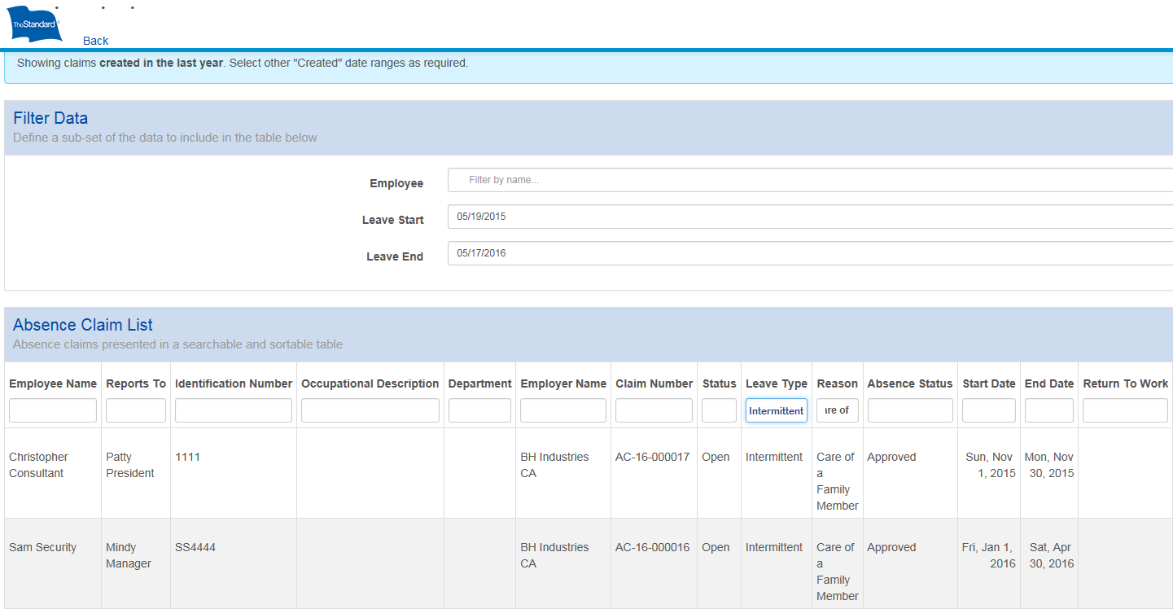
Absence Claim List
Search by value(s) and the report will edit
For smart phones, swipe to navigate left to right
For computers, click, then use arrow keys to navigate left to right

Slide 46
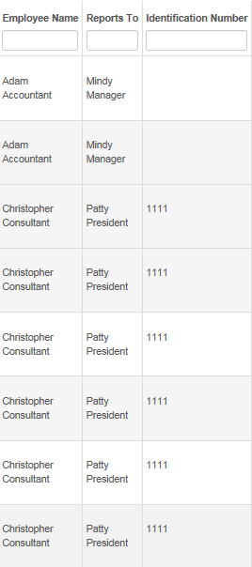
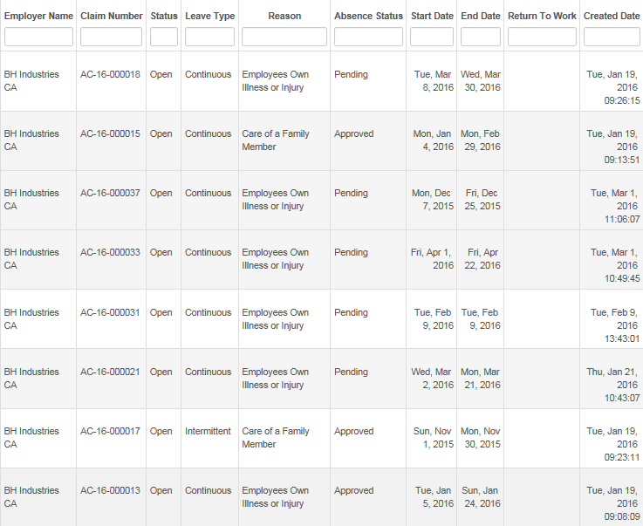
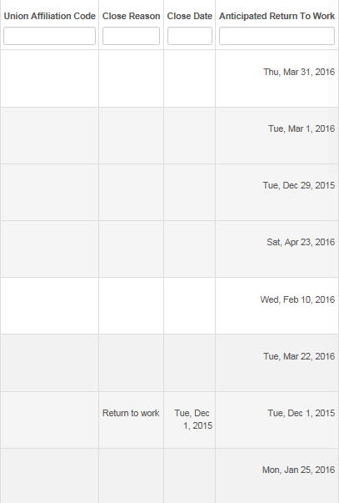
Absence Claim List
Search by value(s) and the report will edit
For smart phones, swipe to navigate left to right
For computers, click, then use arrow keys to navigate left to right

Slide 47
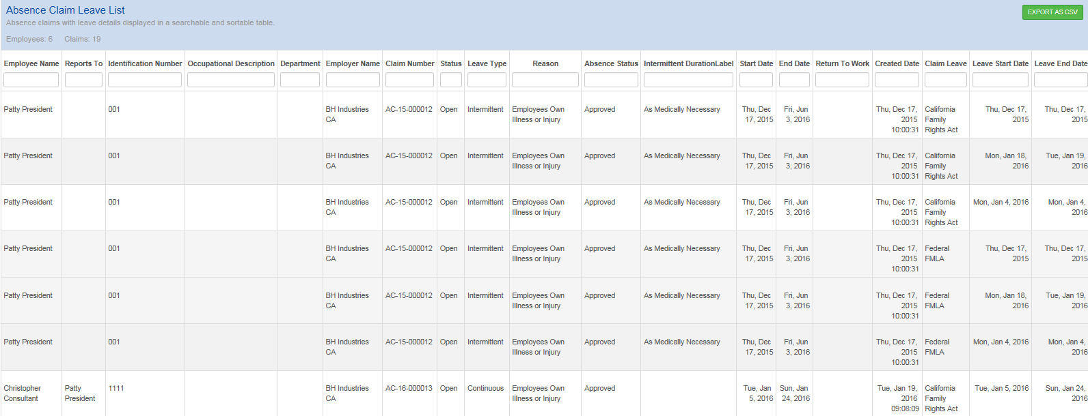
Absence Claim Leave List
Similar to the Absence Claim List
Search by absence categories: Intermittent Duration, Claim Leave, Leave Start Date, Leave End Date, Leave Status

Slide 48
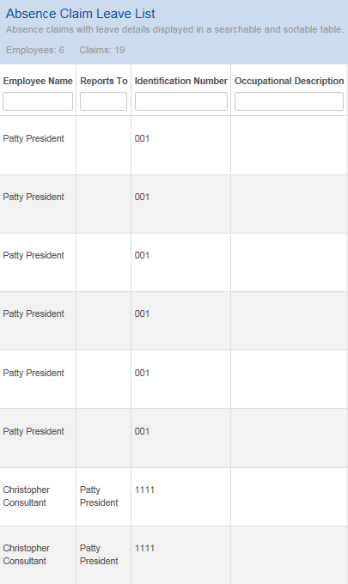
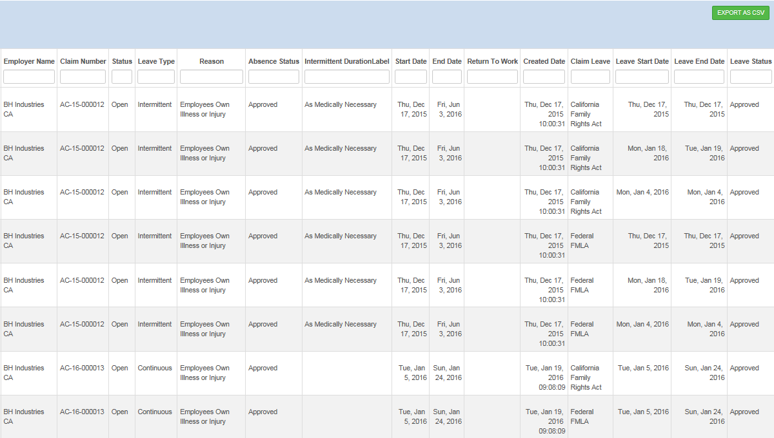
Absence Claim Leave List
Similar to the Absence Claim List
Search by absence categories: Intermittent Duration, Claim Leave, Leave Start Date, Leave End Date, Leave Status

Slide 49
Portal – Employee View

Slide 50
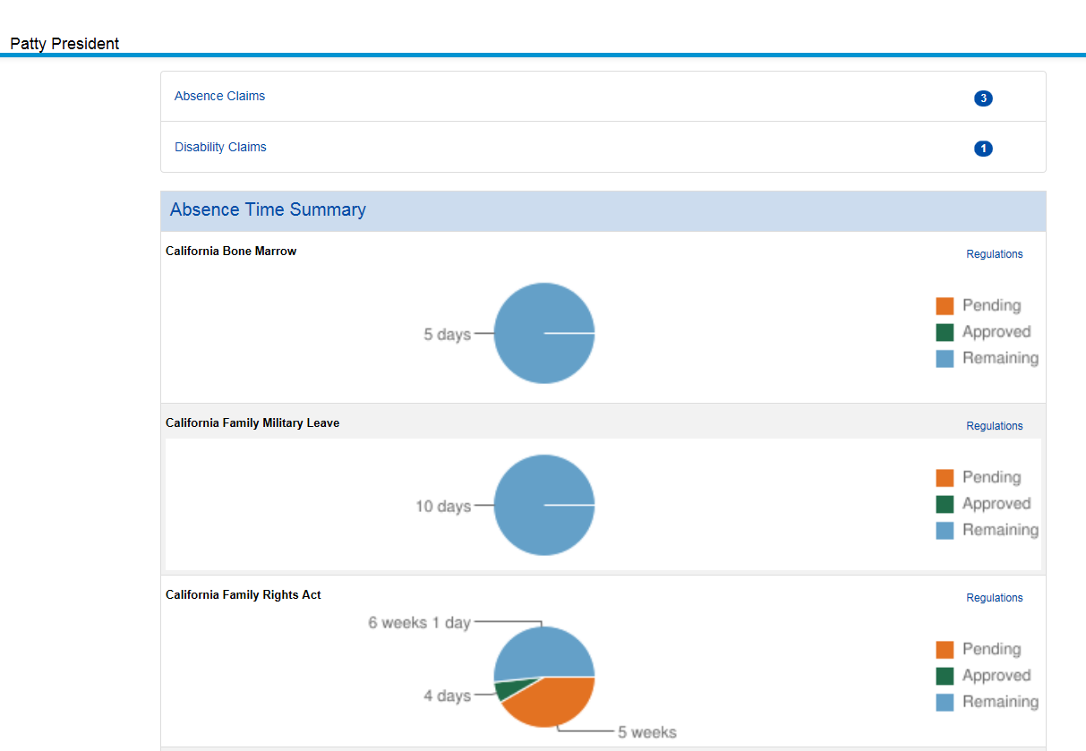
Employee Landing Page
Employee can select reports to view time out of work by absence claims or disability claims
Provides pie chart graphs for policies available at Federal and State Level
Let’s drill down on absence claims

Slide 51
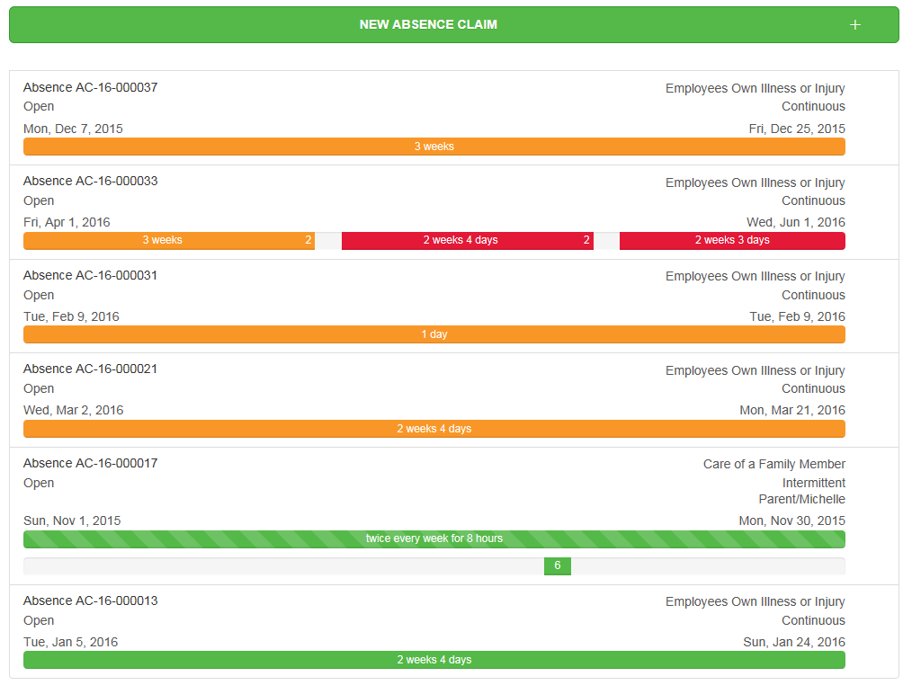
Employee Leaves
File a new leave online
by selecting the “+” sign
Color coded leave and/or absence status:
  Green: Approved
  Orange: Pending
  Red: Denied
View claim details by clicking on the colored bar for the associated leave

Slide 52
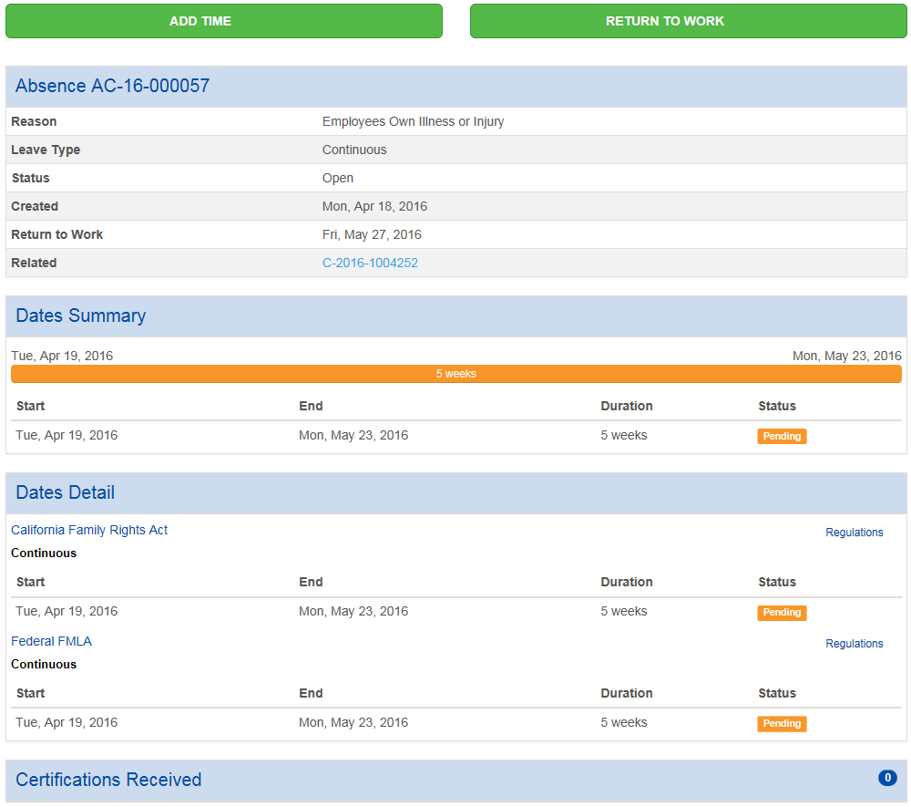
Employee Continuous Leave
Detailed view of:
  Leave
  Dates Summary
  Dates Detail
  Certifications received
Select “Regulations” for the associated policy to get help with regulations
Add time to the leave and/ or report your return to work

Slide 53
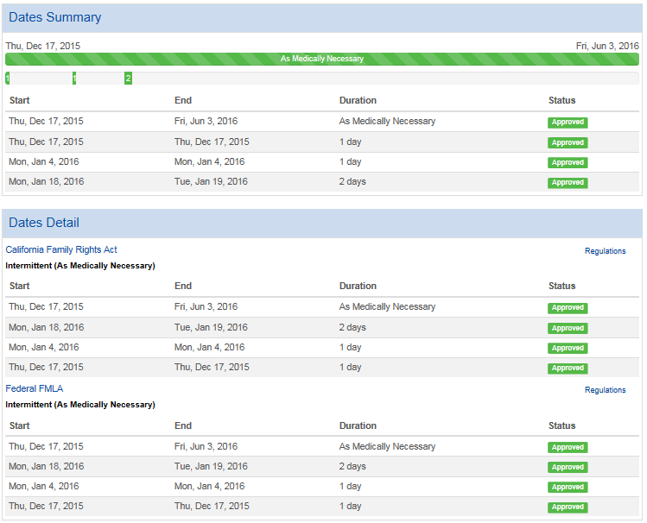
Employee Intermittent Leave
Detailed view of intermittent leave
  Certifications, approved frequency, and duration
  Absences taken capturing duration
  Absence taken by policy

Slide 54
FMLA 101

Slide 55
FMLA Overview
Employees are eligible for FMLA if they have worked for an employer for at least 12 months and have worked 1,250 hours within the previous 12 months.
Employees should initiate an FMLA leave if they will be away from work continuously or intermittently for any of these reasons:
Own serious health condition (including pregnancy and work-related)
Care for a newborn child,
Placement of adopted or foster child
Care for a qualifying family member with a serious health condition
Care for a covered service member injured in the line of duty
Qualified military exigency – to deal with issues arising from a family member being called to serve in the military

Slide 56
Basic Provisions
Up to 12 weeks of job protected leave (unpaid)
Leave may be continuous, intermittent or reduced schedule
Benefits continue (medical, dental, vision)
Employer must fully inform employee of their rights
  Posters in the workplace
  Regular communication processes
Employer may require medical certification of any serious health condition creating the need for leave
  Certification form is government regulated

Slide 57
Definitions
Absence: Any time away from work
Planned (vacation/holidays)
Unscheduled (less than 3 days)
FMLA/Family Medical Leave: Job-protected time away from work
Employee’s own serious health condition
Qualifying family member’s serious health condition
Short Term Disability: Income replacement for time away from work due to an employee’s own serious health condition
Extended (3+ days)
Leave of absence

Slide 58
Leave Types
Concurrent Leave/Short Term Disability Claim (Combo)
Leave and Short Term Disability
Standalone Leave
Leave only
Continuous Leave
Leave taken in a block; more than 1 day
Intermittent Leave
Hours, minutes or days of leave taken sporadically
Reduced Leave
Planned leave taken to reduce work hours in a day or work week
Example: Medical provider indicates employee can work 8 hours per day, 3 days per week

